Slide 1


IDS 1721
Computing and Problem Solving for STEM
Chapter 05
Abstraction

Slide 2
Learn the concepts for:
  Functions, specification, implementation, local variables, parameters, output parameters, call-by-value, efficiency, level of abstraction, subfunctions, in-line code
  Learn language features:
    Function: A named set of statements stored in a MATLAB-file. A function may have any number of input parameters and output parameters.
    Subfunction: A function MATLAB-file may contain more than one function. The top function is the main function and is accessible by scripts and other functions

Slide 3
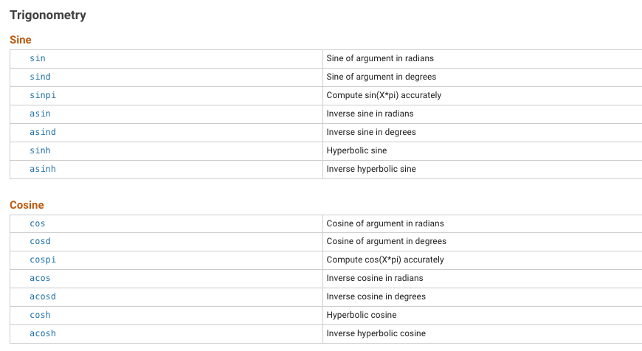
As we know, MATLAB has a plethora of built-in functions…

Slide 4
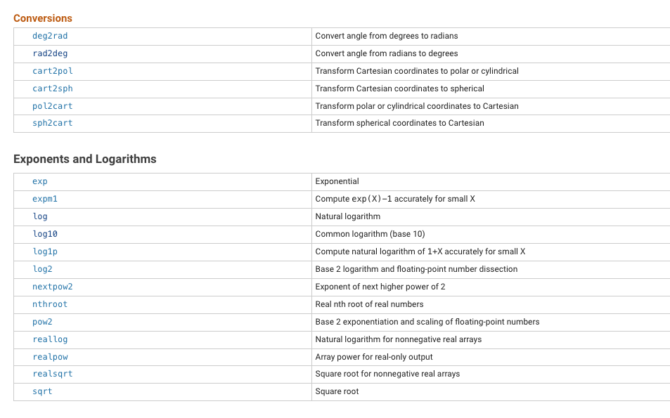
As we know, MATLAB has a plethora of built-in functions…
And many more…

Slide 5
The built-in sin function is so handy that we don’t know how it works; it just works, so it’s like a “black box”.
All we need to know is that sin expects a real input value and that it outputs the sine of that value interpreted in radians.
The code is shorter since it uses a built-in function rather than creating the code for it.
The resulting program is shorter and harmonizes better with our mathematical thinking.
Being able to write effective functions is central to the problem-solving process.
It supports the top-down methodology, enabling us to hide lower-level details while we address higher-level design issues.

Slide 6
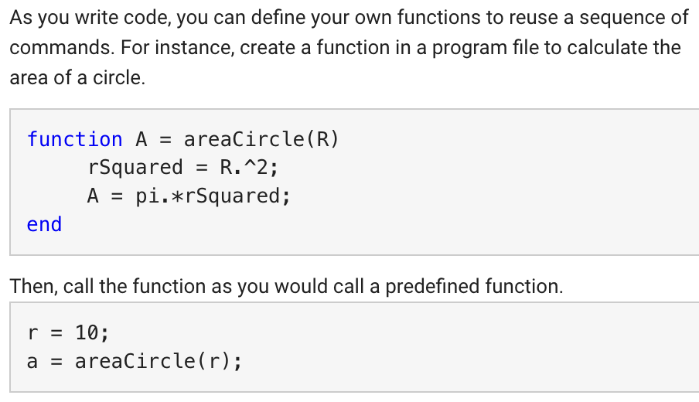

Slide 7
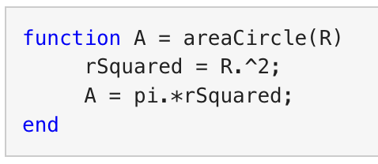
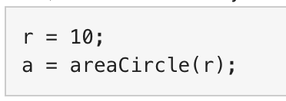
Output variable
Function Name
Input Variable
Functions are created as m-file where the file name must match the function name.
---> areaCircle.m
Input value
Command Window
OR
separate Script file
Let's try that in the Command Window!
Call function

Slide 8
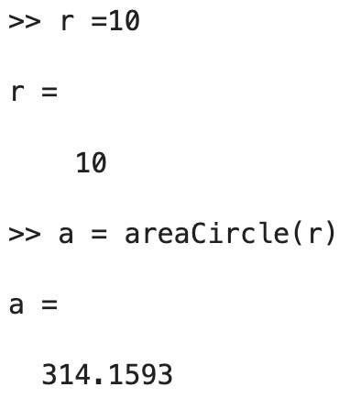
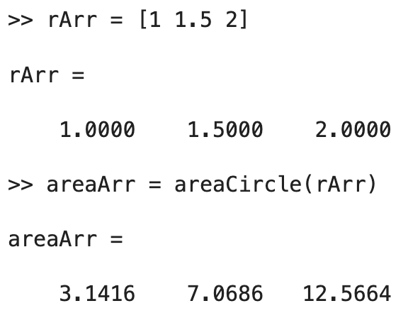
Notice that the way we designed the function, input variable can be an array of numbers too.

Slide 9
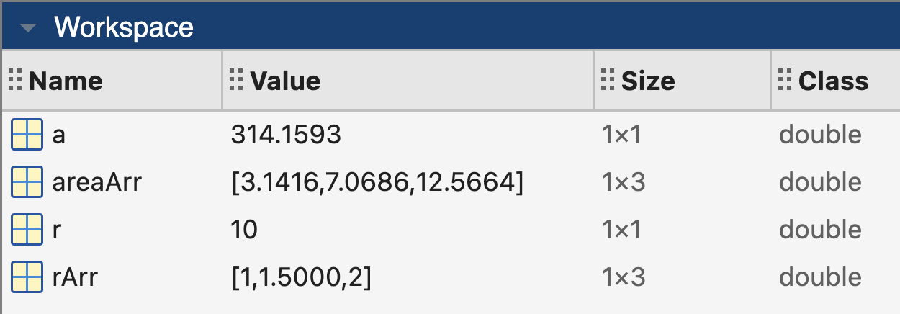
Observe the workspace
Notice that the variables used for the function does not show up in the workspace.
The variables used for the function are local to the function.
Variables defined in the command window, or the main script file, show up in the workspace.

Slide 10
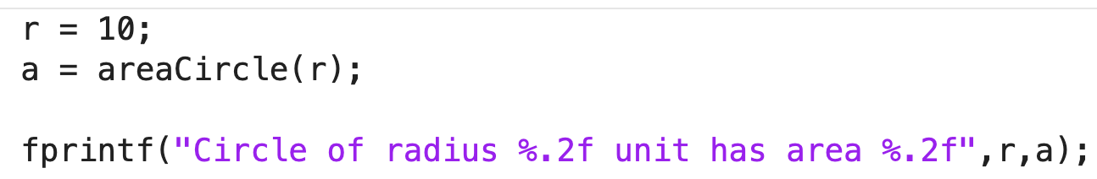
Call a function in your program (script file)
Create your own code in another m-file.
Call the function inside this file like a built-in function.
Run this main script.
Let's create and run the script...
areaCal.m

Slide 11
Functions are useful in MATLAB because they allow programmers to create repeatable code that can be used in multiple places.
Divide programs into smaller tasks.
Each function has its own scope, which helps prevent confusion about which variable is being used.
Functions are flexible multiple inputs and return multiple outputs.

Slide 12
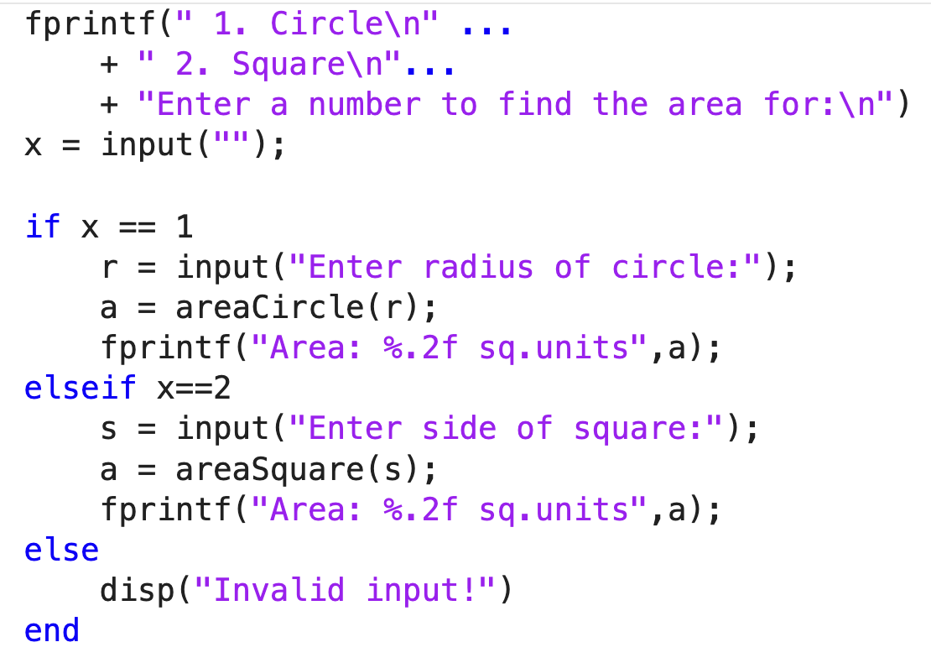
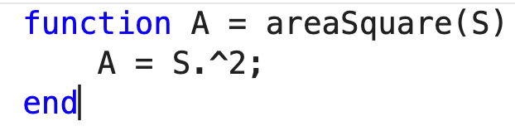
Function: Area of square
We can add a feature using a new function.
Modify the main script to include this function.

Slide 13
Exercise 1
Modify the above script to add options for finding area of rectangle and area of triangle.
Construct functions with appropriate inputs and outputs to achieve the above.
NOTE: We can define a function with multiple inputs as,
function A = areaRectangle(length, width)

Slide 14
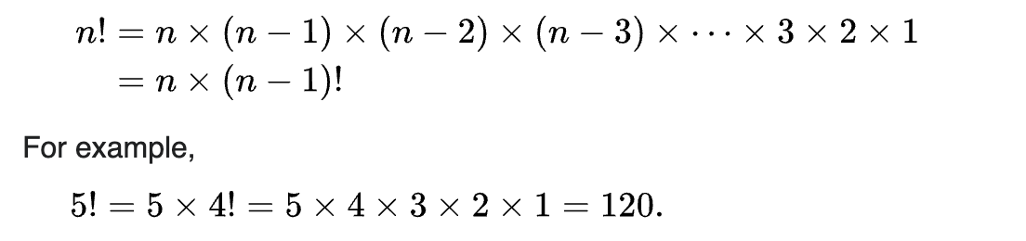
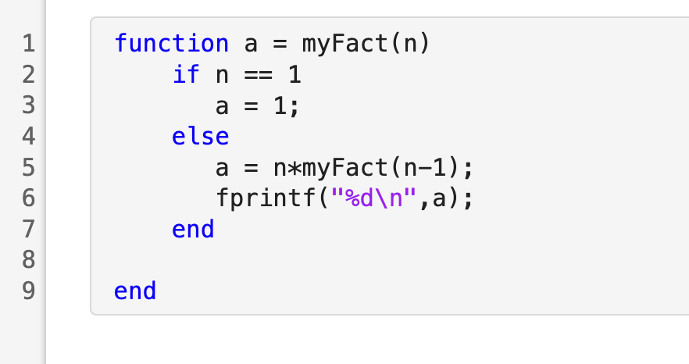
Exercise 2
Can we make a custom factorial function?
Call this function in a main script factComp.m for a value of n = 5
Check your work by using the MATLAB built-in function factorial
Compare the times for both methods using the MATLAB functions tic & toc

Slide 15
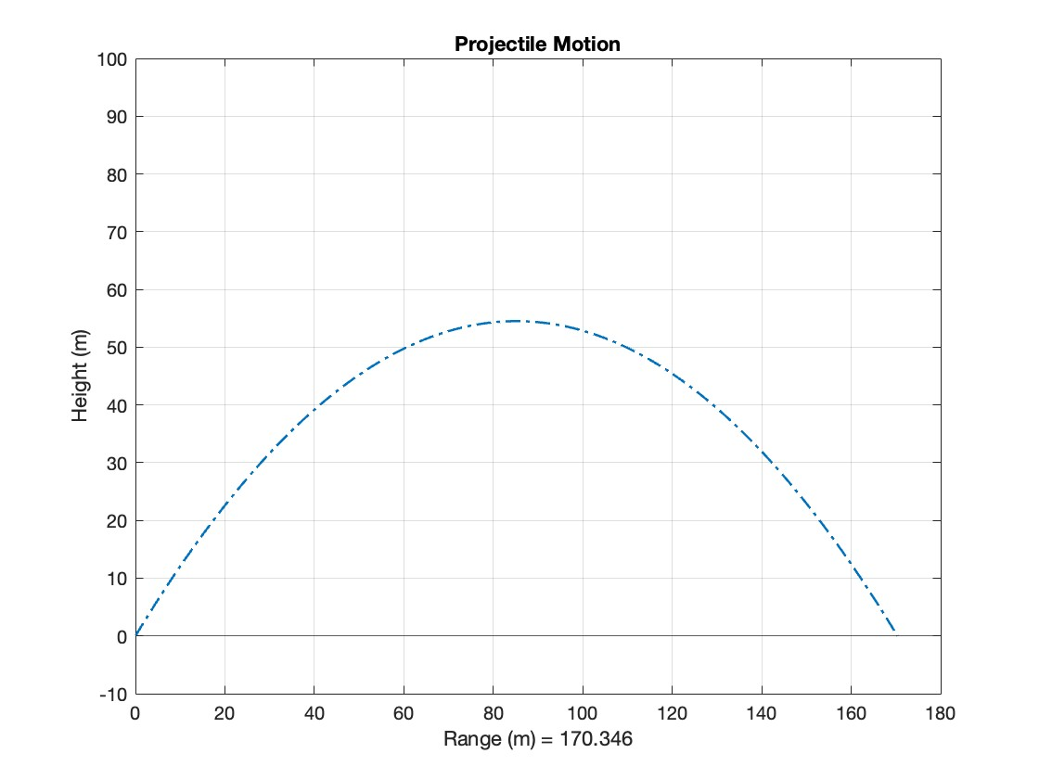
Exercise 3
Create a custom Projectile Motion function with initial velocity and initial angle as the input parameters.

Slide 16
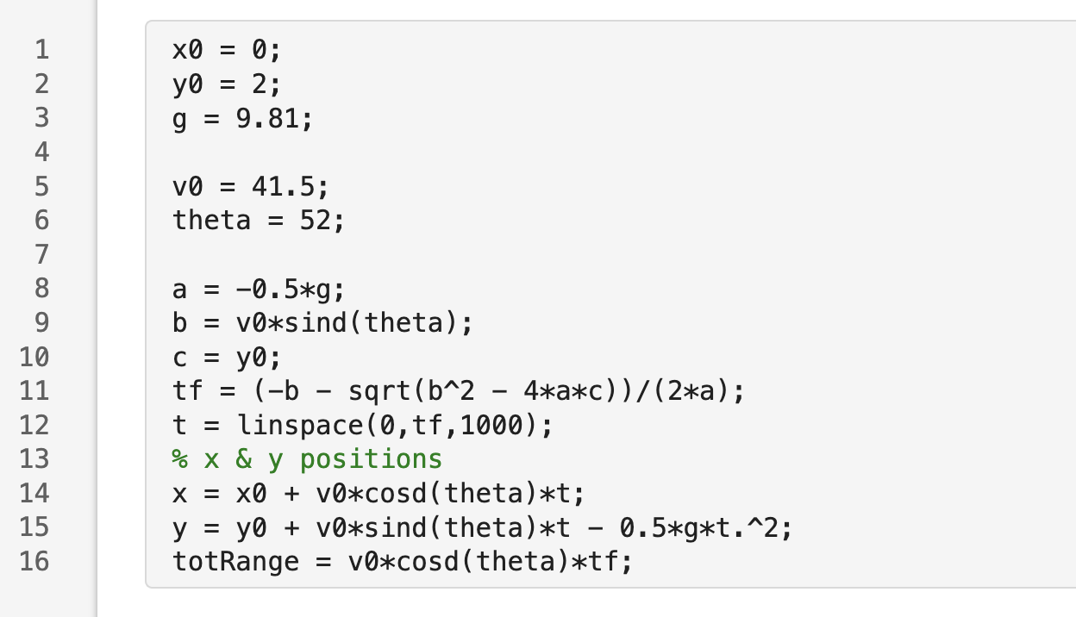
Chapter 5: Abstraction
Recall
Modify this code and make it a function where:
  v0 and theta are function inputs
  And the outputs are the x, y positions, and the total range – so, 3 outputs
Call this function in your lect14ExP1.mlx script
Run it for the following values:
  θ = 30 degrees
  V0 = 25 m/s
Visualize and annotate your results – That is plot your x and y positions

